Slide 1
Matrix Protocol
Over-collateralized, decentralized and capital-efficient reserve protocol using Cosmos-SDK.

Slide 2
Matrix Protocol mints stable assets that are traded on the blockchain
Matrix Protocol enables swaps between speculative assets and collateral at oracle value. The volatility of the collateral in the reserves is hedged using perpetual futures.
Like most decentralized stablecoin protocols, Matrix aims for over-collateralization to keep the trust in the protocol and sustain convertibility. The solution proposed by Matrix to get over-collateralized is to resort to Liquidity Providers (LPs)1, that is extra agents that bring collateral to the protocol and help it manage its risk.
Creating a decentralized, truly stable token
Matrix will initially offer to swap Osmosis collateral for NEO at
oracle value. Functionality for other forms of collateral will be developed
1
2
Swap back and from at 1:1 rate
The convertibility of the stablecoin to the collateral and vice versa will be done with a DEX swap mechanism.
3
Sustainable convertibility
Because of the tradeoffs in liquidity providing incentives, Matrix is stays over-collateralized to manage the risk of the asset.
4
3 groups working together
Stable seekers use the stable assets Liquidity Agents buy perpetual futures on those funds Insurance Agents balance the protocol

Slide 3



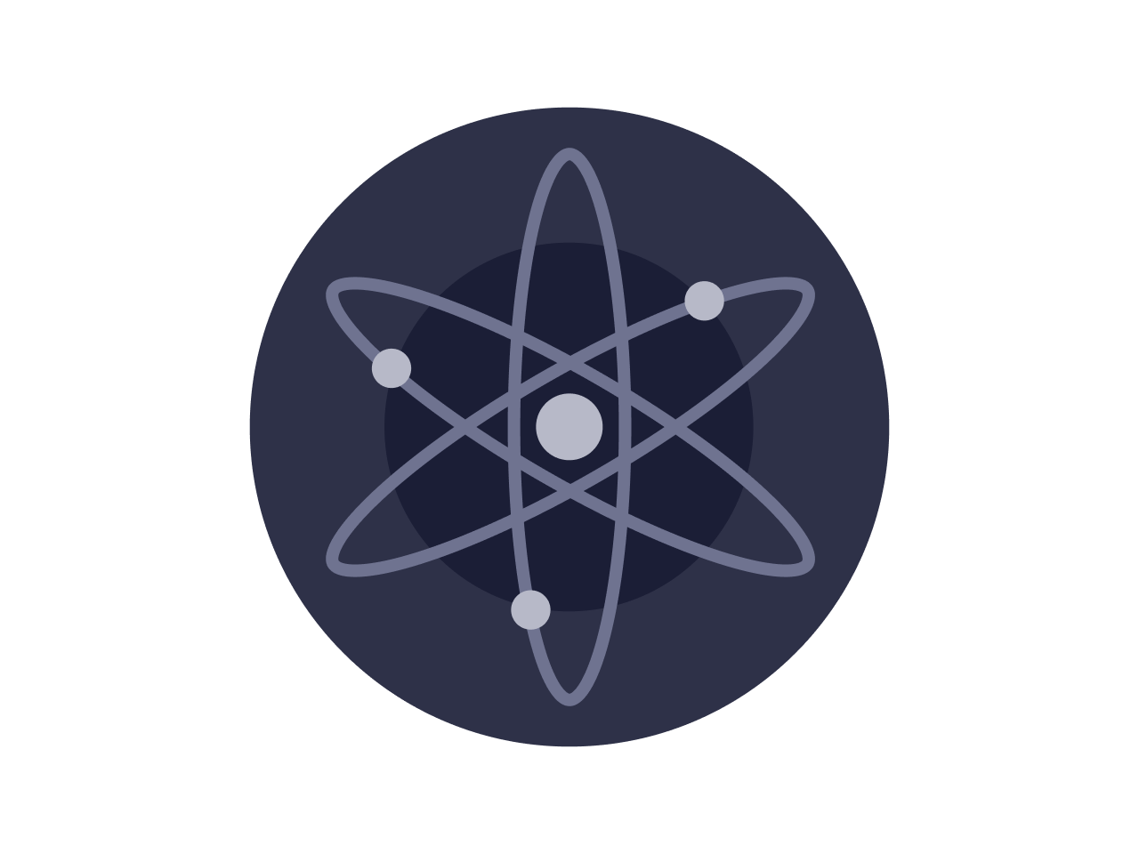



Matrix is launching a collateral-backed stablecoin, USDM.
Matrix enables users to swap between collateral and stablecoins at oracle value with small fees.
From a user perspective, swaps can occur on trading pairs like ATOM:USDM and OSMO:USDM.
Buying m-stables: When a user deposits (brings) collateral, Matrix will mint and give an equivalent value in USDM to the user.
Selling m-stables:
When a user withdraws (receives) collateral, Matrix will burn the equivalent value in USDM brought by the user.
User swaps whitelisted collateral with USDM
Price Feed
Chainlink Oracle and AMM prices specify the amount of USDM to mint.
Matrix Protocol
User
Notes:
roc=\frac { \left( 1-f_d \right)xy}{x+k\left( 1-f_d \right)}\times \left( 1-f_{td} \right)\times bid \times \left( 1-f_c \right) \times \left( 1-f_{tc} \right) -1

Slide 4
Oracle and AMM prices determine the exchange rate between m-stables and collateral.
To mint or burn USDM, it must be swapped with whitelisted collateral.
Matrix Protocol
Oracle
Our plan is to follow the Kava model. ⇒ Use Chainlink’s decentralized oracle network. Chainlink oracles can provide secure and reliable reference prices for the entire Cosmos ecosystem.
Ref: https://medium.com/kava-labs/bringing-chainlink-oracles-to-cosmos-24e7ec7f006d

Slide 5
Stability of the m-stables is maintained by 2 key types of liquidity providers.
Leverage Agents (LAs) Leverage agents are liquidity providers take long, leveraged positions on collateral price with respect to the stablecoin, USDM.
Insurance Agents (IAs) Insurance agents are the buffer for the moments when Leverage Agents do not fully cover the collateral that was brought by users, and when the protocol’s reserves are not fully insured.

Slide 6

Leverage Agents buy perpetual futures from the protocol.
Leverage agents take on the volatility of the asset they are providing liquidity for, earning a lot in case of a price increase but incurring losses when price goes down.
Swap 5 OSMO for 50 NEO in the protocol
Entitled to stability of the NEO in case of loss of value for collateral
Stablecoin seeker
Deposit 2 OSMO as collateral
LA covers 10 OSMO for Matrix, getting 5x leverage on their position
Receive capital gains or loss on the 10 OSMO
Potentially gets liquidated if position drop below 0
Leverage Agents

Slide 7
Insurance Agents bare the liquidation risks in exchange for interest gained on their capital.
When lending money to over-collateralized the protocol, these agents are taking a small risk that needs to be incentivized. IAs collect fees from token minting and from protocol liquidity that’s invested in strategies on Umee & Axelar. They effectively earn interest on both the collateral they bring, as well as the collateral given by stablecoin seeker.
Deposit OSMO in the protocol for NEO
Pays transaction fees to the protocol for the minting
Stablecoin seeker
Deposit liquidity in the protocol and stake governance tokens
Protocol earn interest on both collateral provided
Share of this income is distributed back to insurance agents
This allows user to get higher low speculative yield than other platforms
Insurance Agents

Slide 8
Risks for agents
—
Although the incentives for Insurance Agents are greater than other platforms, some risks also appear due to the nature of the protocol.
Insurance Agents are here to ensure that the protocol is solvent when there’s an imbalance between stable seekers and Leverage Agents.
Insurance agents will see slippage when the protocol is not collateralized enough.
Slippage risk for Insurance Agents (IA):
1000 USDM are minted in exchange for 100 OSMO, indicating a prie of $10 OSMO/USDM.
An IA brings 1 OSMO to the protocol, and will earn yield rate on 11 OSMO plus a fraction of the fee collected from swap
OSMO dips at $800, and makes the protocol under-collateralized.
If the IA wants to cash out a tenth of her position, she will only be able to get 0.9 OSMO.
The slippage factor will be a piecewise linear function of the collateral ratio to make risk predictable while incentivizing them to stay in the protocol.
When the protocol is above a certain collateral ratio, the IA won’t incur any slippage.

Slide 9
Protocol opportunities
The protocol will be governed by the vNEO token. More than 60% of this token will be distributed through staking contracts and bonding curve using the protocol’s stable coin. This governance will be used to define further improvements to be taken in the chain and allows for the protocol to explore new opportunities
Yield strategies
Lending part of the reserves to other lending platforms makes the protocol attractives to the IAs. They leverage their capital and increase the effective yield of their funds.
The design for new strategies can be added along the way by governance votes. The protocol aim at supporting multiple lending platforms.
The first strategy will optimize lending with the best APY to incentivize IAs.
Agent smith
External incentivized actors are needed to perform actions regularly on the platforms.
LAs positions need to be liquidated when the value is too low. Keepers should monitor LAs in the protocol for these and be rewarded with the initial fees paid at opening.
They needs to compute the collateral ratio which is too expensive to compute on each transaction.
Distribute governance token based on parameters set by governance
Minting
Matrix aims to be a protocol that lets user mint the synthetic pegged to the asset of their choice with the collateral of their choice.
Synthetics are going to be launched soon after the launch of the initial stablecoin.
To keep the system resilient, all stable coin will be independent for both collateral and stablecoins: a UATOM and UOSMO token will have each their own pool with ATOM and OSMO collateral.

Slide 10
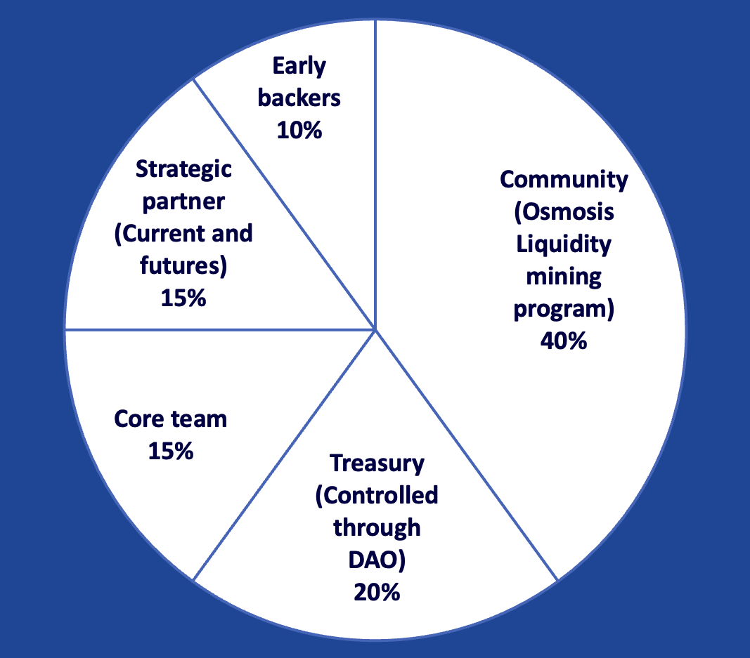
Introducing MTRX, the governance token for the Matrix Protocol
The Matrix protocol plans to distribute 40% of its supply through liquidity mining over 10 years.
The initial design will be done off-chain by multisig held by the Core team. Governance will be able to change these parameters and remove the multisig if the community prefers to do it.
The philosophy of this distribution is to incentivize early users and avoid short-term mercenary capital. The distribution also aims at having ways to attract new participants over the long term.
Tokens of the core team are subject to a 3-year vesting to make sure that founders and team remain fully committed to the protocol and community. Only 0.3% of the total supply will be made available initially, with the remaining following a linear vesting schedule.
Neo token distribution: 1,000,000,000 total supply

Slide 11
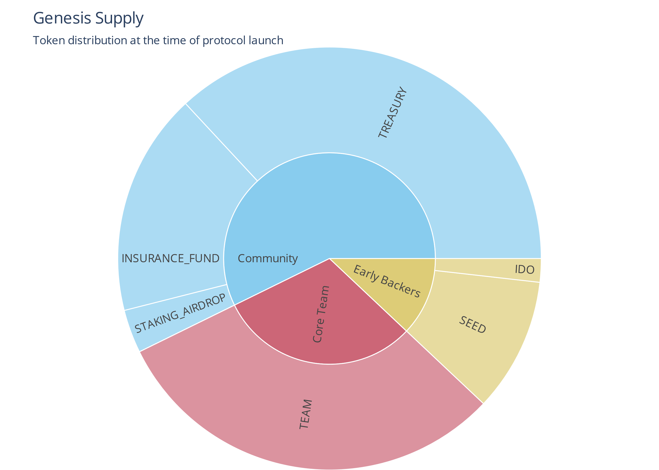
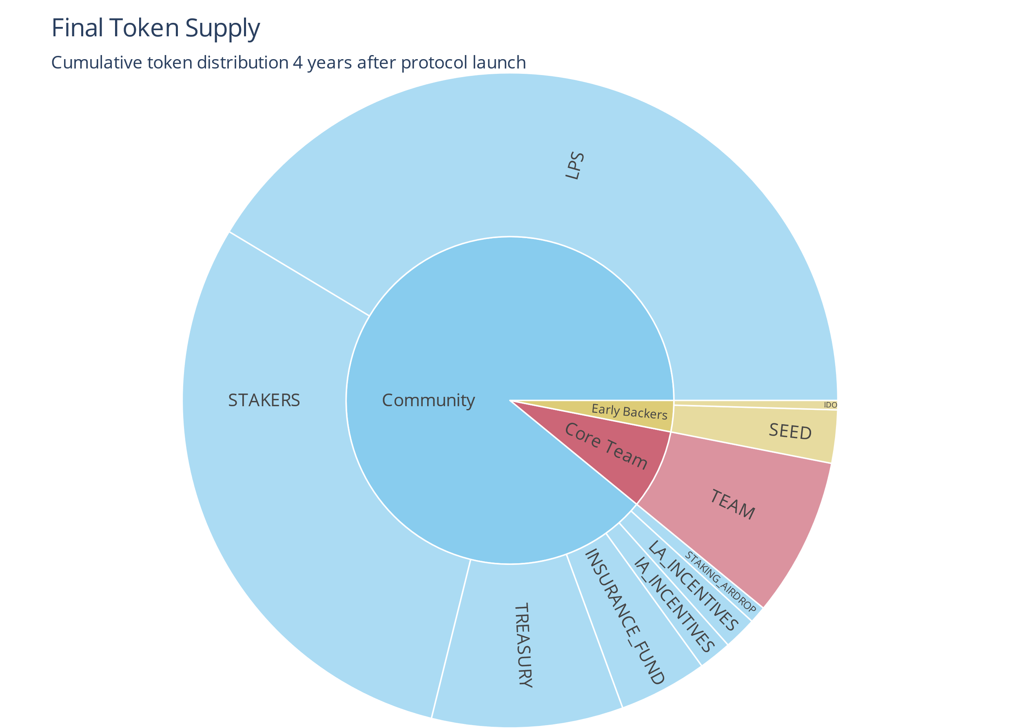

Slide 12
For additional inquiries, contact our team at @@@

